Slide 1
Image Classification
Using CNN & Using Pre-trained Self-supervision model

Slide 2
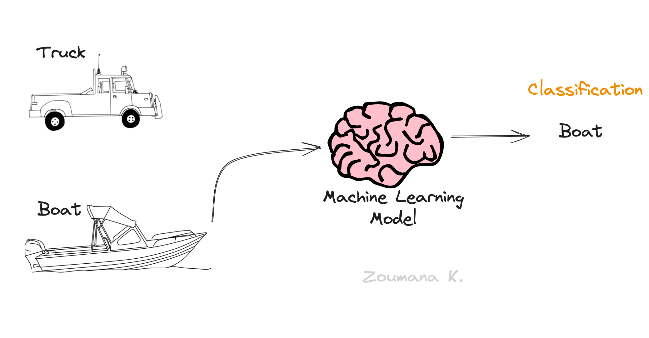
What is Image Classification?
Image classification is a task in computer vision where a machine learning model is trained to categorize images into predefined classes. The goal is to teach the model to recognize and distinguish between different objects, scenes, or patterns within images. This process involves feeding labeled images into the model during training, allowing it to learn the characteristic features associated with each class. Once trained, the model can then predict the class of new, unseen images based on the patterns it has learned from the training data. Image classification has various applications, including object recognition, medical diagnosis, autonomous driving, and more.

Slide 3
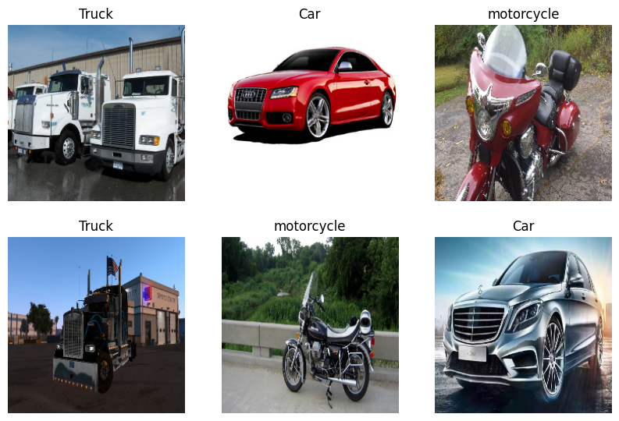
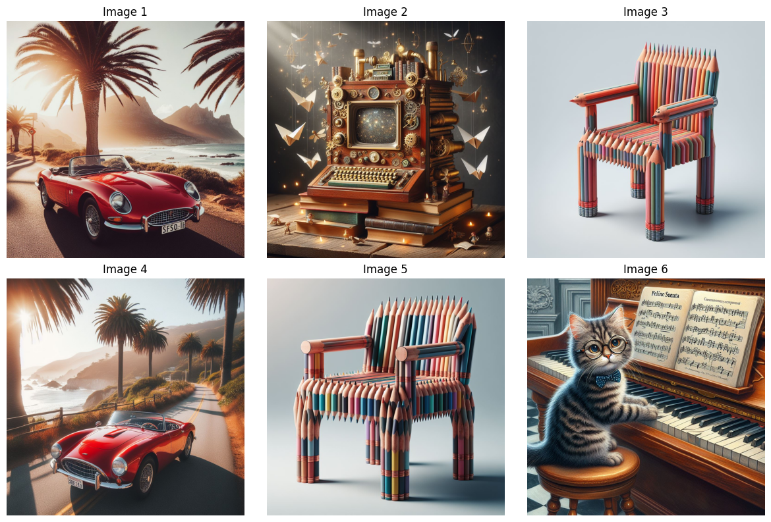
Datasets
For our image classification project, we’ve build two datasets:
Real Images Dataset: This dataset comprises manually collected images from Google Images, featuring four categories: car, bus, truck, and bike. These images are used for training and fine-tuning the model.
Synthetic Dataset: Synthetic Dataset created with the help of DALL-E 3, These images are used for making predictions using a pre-trained Vision Transformer (ViT) model.

Slide 4
Models
Initially, we built a Convolutional Neural Network (CNN) from scratch. Subsequently, we employed transfer learning with ResNet50 and MobileNetV2 models. Finally, we fine-tuned the ResNet101 model. All models were trained and fine-tuned using a real image dataset.
For CNN model we use the Adam optimizer with a learning rate of 0.001 to optimize the model's parameters during training. For the loss function, we use sparse categorical cross-entropy. We train the model for 20 epochs, with a specified batch size of 64. The accuracy achieved is: 67.6%
For ResNet50 Model we use the Adam optimizer with a learning rate of 0.001 to optimize the model's parameters during training. For the loss function, we use sparse categorical cross-entropy. We train the model for 20 epochs, with a specified batch size of 32. The accuracy achieved is: 92.5%
Model Name | Accuracies
Fine-Tune ResNet101 | 93.3%
ResNet50 | 92.5%
MobileNetV2 | 69.9%
CNN Model | 67.6%
For MobileNetV2 Model we use the Adam optimizer with a learning rate of 0.001 to optimize the model's parameters during training. For the loss function, we use sparse categorical cross-entropy. We train the model for 20 epochs, with a specified batch size of 32. The accuracy achieved is: 69.9%
To Fine-Tune ResNet101 Model we use the Adam optimizer with a learning rate of 0.001 to optimize the model's parameters during training. For the loss function, we use sparse categorical cross-entropy. We train the model for 20 epochs, with a specified batch size of 32. The accuracy achieved is: 93.3%

Slide 5
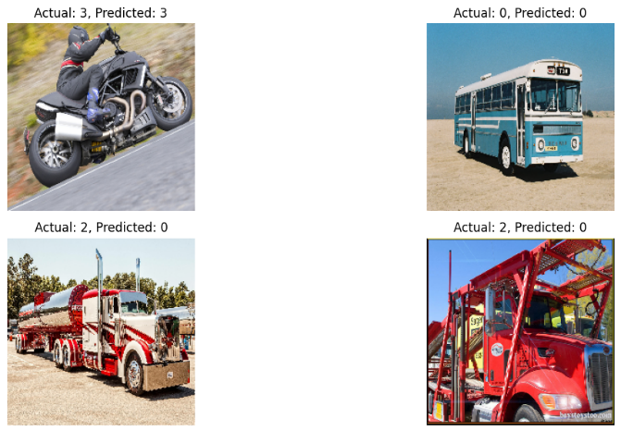
Predictions
Ground truth images alongside their corresponding predicted labels using CNN Model.

Slide 6
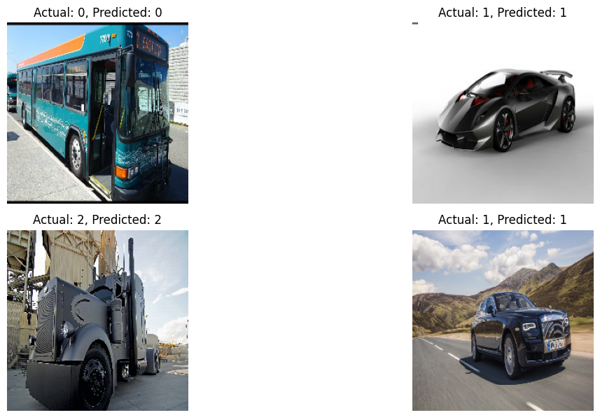
Predictions
Ground truth images alongside their corresponding predicted labels using ResNet50 Model.

Slide 7
Predictions
Ground truth images alongside their corresponding predicted labels using MobileNetV2 Model.

Slide 8
Predictions
Ground truth images alongside their corresponding predicted labels using Fine-Tune ResNet101.

Slide 9

Pre-trained Self-supervision model
For classification task we have used pre-trained self-supervision models, we've explored three different architectures known for their efficacy in handling diverse visual tasks:
ViT-base-patch
Data-efficient Image Transformer (DeiT)
DINOv2
Synthetic Dataset:
For the pre-trained self-supervision models, I generated a synthetic dataset using a DALL-E 3. This synthetic dataset comprises various images, including astronauts, thrones, and cars.

Slide 10
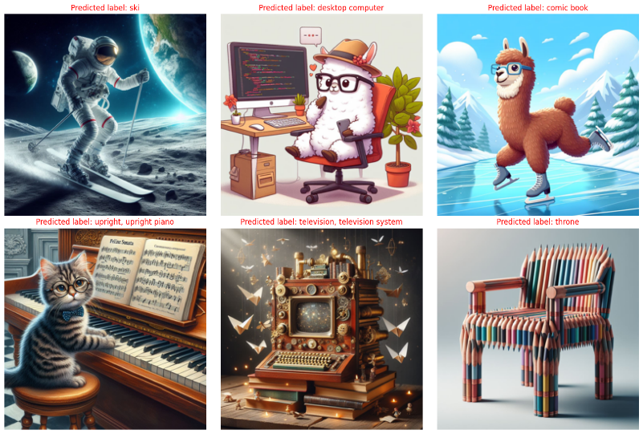
ViT-base-patch
predicted labels from ViT-base-patch
Vision Transformer (ViT) model pre-trained on ImageNet-21k (14 million images, 21,843 classes) at resolution 224x224, and fine-tuned on ImageNet 2012 (1 million images, 1,000 classes) at resolution 224x224. It was introduced in the paper An Image is Worth 16x16 Words: Transformers for Image Recognition at Scale by Dosovitskiy et al.

Slide 11
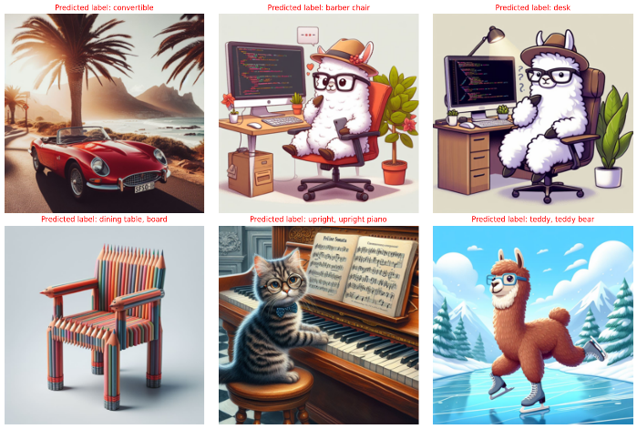
Data-efficient Image Transformer (DeiT)
predicted labels from DeiT
DeiT (Data-efficient Image Transformers) by Facebook AI. DeiT models are distilled vision transformers. There are 4 variants available (in 3 different sizes): facebook/deit-tiny-patch16-224, facebook/deit-small-patch16-224, facebook/deit-base-patch16-224 and facebook/deit-base-patch16-384. But we have used facebook/deit-tiny-patch16-224 for our classigfication task.

Slide 12
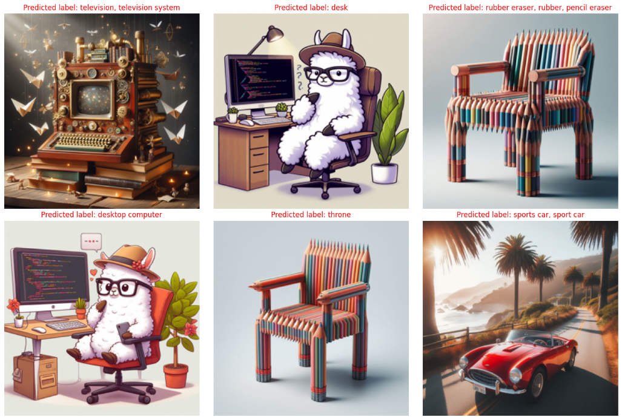
DINOv2
predicted labels from DINOv2
DINO (a method for self-supervised training of Vision Transformers) by Facebook AI. DINOv2-large-imagenet1k is a state-of-the-art self-supervised learning model for large-scale image classification tasks. It shows the effectiveness of ViT-based architectures in learning visual representations from unlabeled data.

Slide 13
References
An Image is Worth 16x16 Words: Transformers for Image Recognition at Scale by Dosovitskiy et al.
Data-efficient Image Transformer (DeiT) by Hugo Touvron, Matthieu Cord, Matthijs Douze, Francisco Massa, Alexandre Sablayrolles, Hervé Jégou
DINOv2: Learning Robust Visual Features without Supervision
Deep Residual Learning for Image Recognition
An Introduction to Convolutional Neural Networks
MobileNetV2: Inverted Residuals and Linear Bottlenecks
Adam: A Method for Stochastic Optimization
Understanding Softmax Confidence and Uncertainty

